Slide 1
Agenda
CLIPS Example
Trees
Graphs
Binary Decision Trees
Semantic Nets
Finite State Machine
Frame

Slide 2
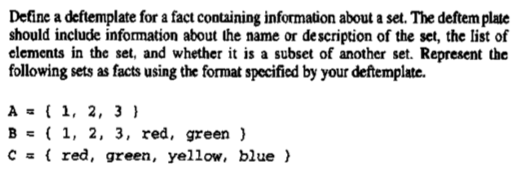
Example

Slide 3
(deftemplate set
(slot name)
(multislot elements)
(multislot subset-of))
A deffacts which represents the given sets is shown following.
(deffacts the-sets
(set (name A)
(elements 1 2 3)
(subset-of A B))
(set (name B)
(elements 1 2 3 red green)
(subset-of B))
(set (name C)
(elements red green yellow blue)
(subset-of C)))

Slide 4
Example: Production Rules

Slide 5
Example: Parse Tree of a Sentence

Slide 8
Trees
A tree is a hierarchical data structure consisting of:
Nodes – store information
Branches – connect the nodes
The top node is the root, occupying the highest hierarchy.
The leaves are at the bottom, occupying the lowest hierarcy.

Slide 9
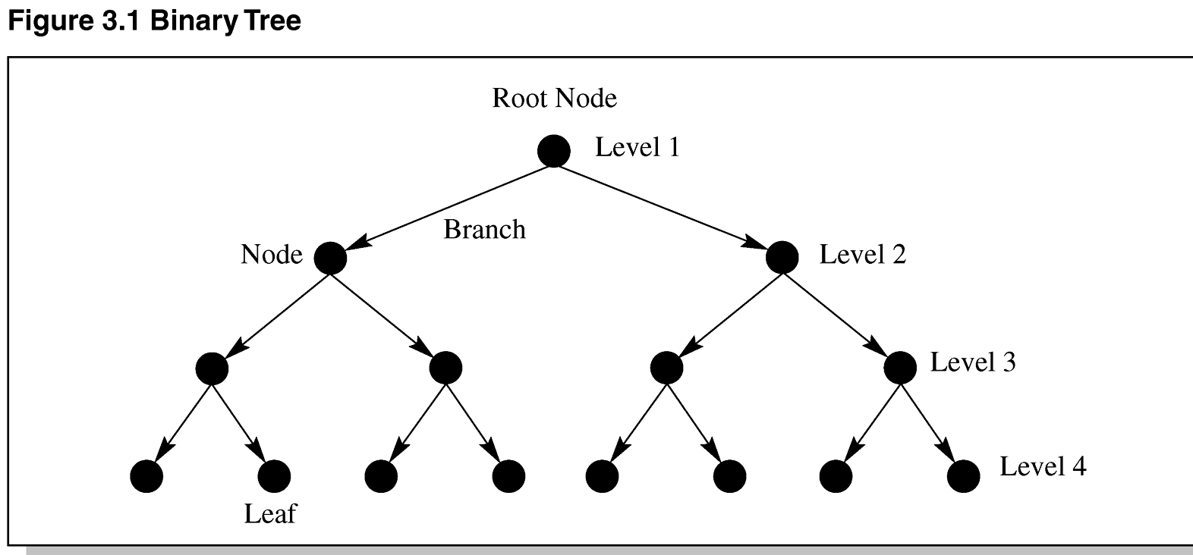
Binary Tree

Slide 10
AND-OR Trees and Goals
PROLOG uses backward chaining to divide problems into smaller problems and then solves them.
AND-OR trees also use backward chaining.
AND-OR-NOT lattices use logic gates to describe problems.

Slide 11
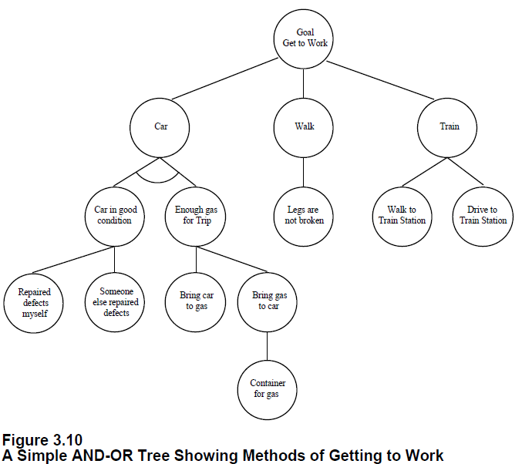

Slide 12
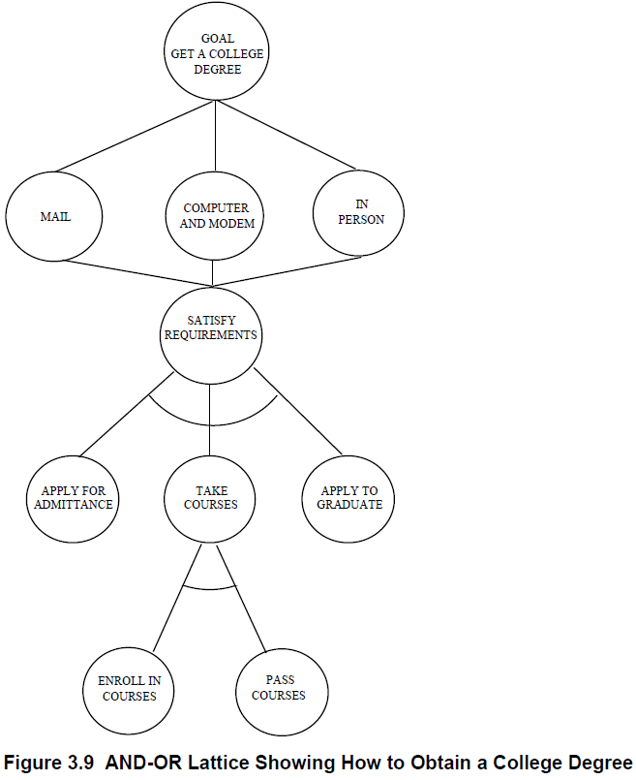

Slide 13
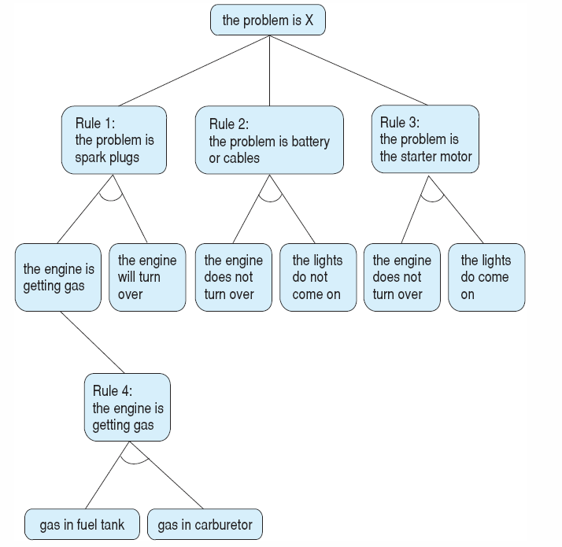
The and/or graph searched in the car diagnosis example,

Slide 14
Graphs
Graphs are sometimes called a network or net.
A graph can have zero or more links between nodes – there is no distinction between parent and child.
Sometimes links have weights – weighted graph; or, arrows – directed graph.
Simple graphs have no loops – links that come back onto the node itself.

Slide 15
Graphs
A circuit (cycle) is a path through the graph beginning and ending with the same node.
Acyclic graphs have no cycles.
Connected graphs have links to all the nodes.
Digraphs are graphs with directed links.
Lattice is a directed acyclic graph.

Slide 16
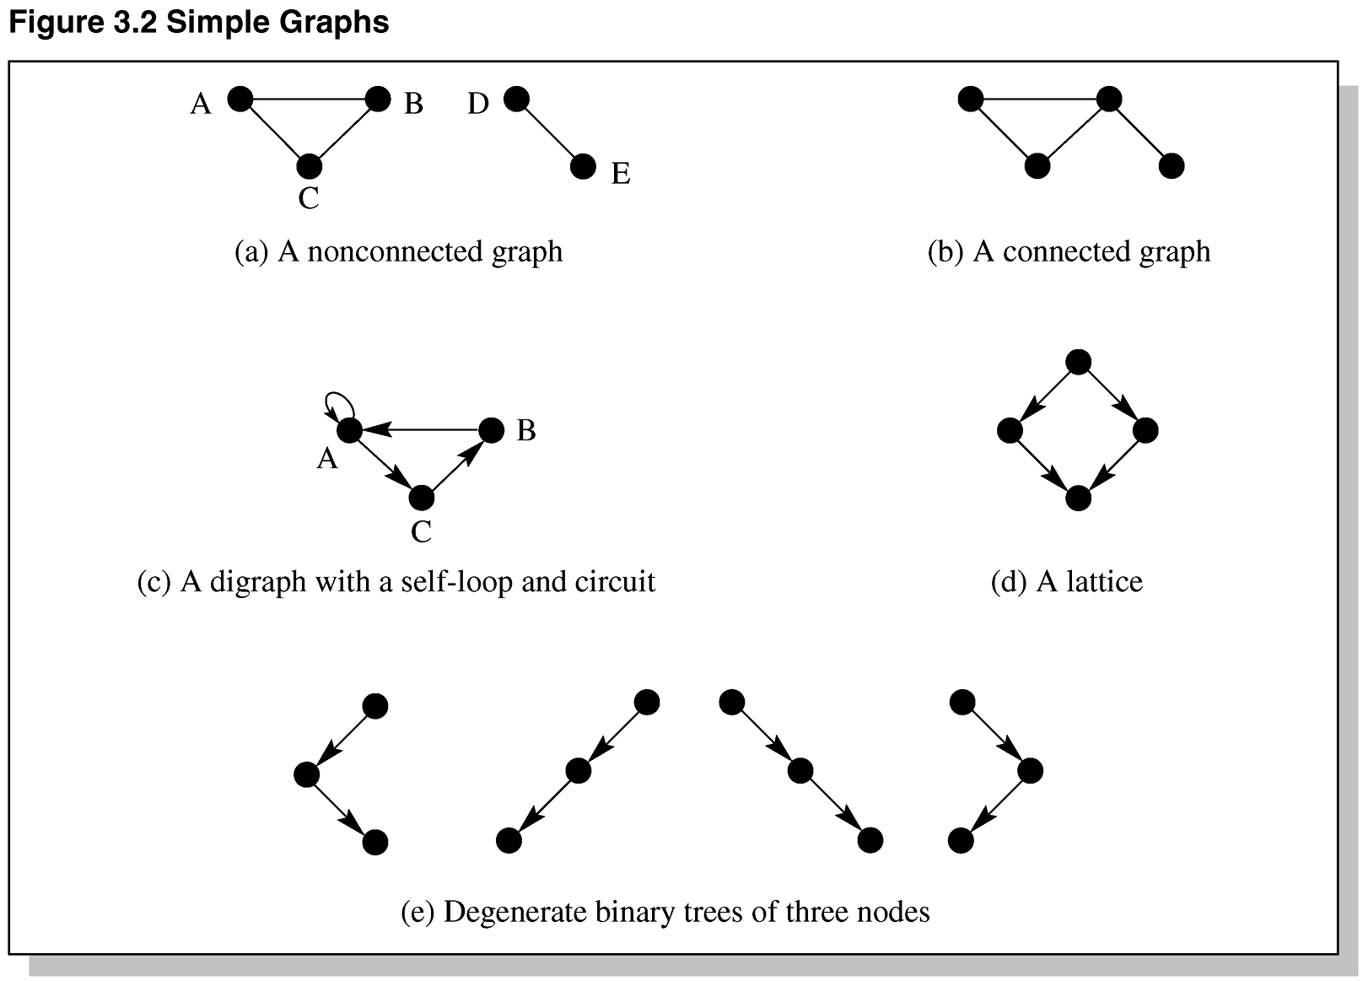
Simple Graphs

Slide 17
Making Decisions
Trees are useful for classifying objects in a hierarchical nature.
Trees are useful for making decisions.
We refer to trees as structures.
Decision trees are useful for representing and reasoning about knowledge.

Slide 18
Binary Decision Trees
Every question takes us down one level in the tree.
A binary decision tree having N nodes:
All leaves will be answers.
All internal nodes are questions.
There will be a maximum of 2^{N} answers for N questions.
Decision trees can be self learning.
Decision trees can be translated into production rules.

Slide 19
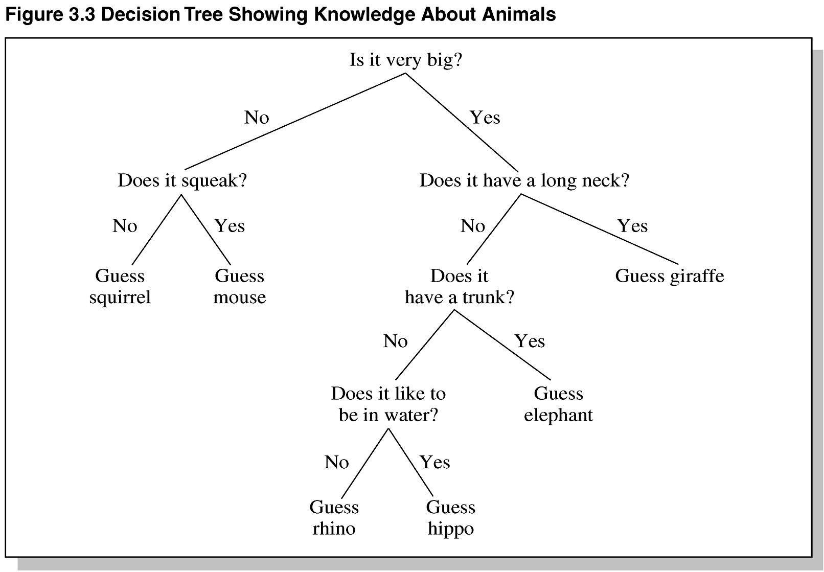
Decision Tree Example

Slide 20
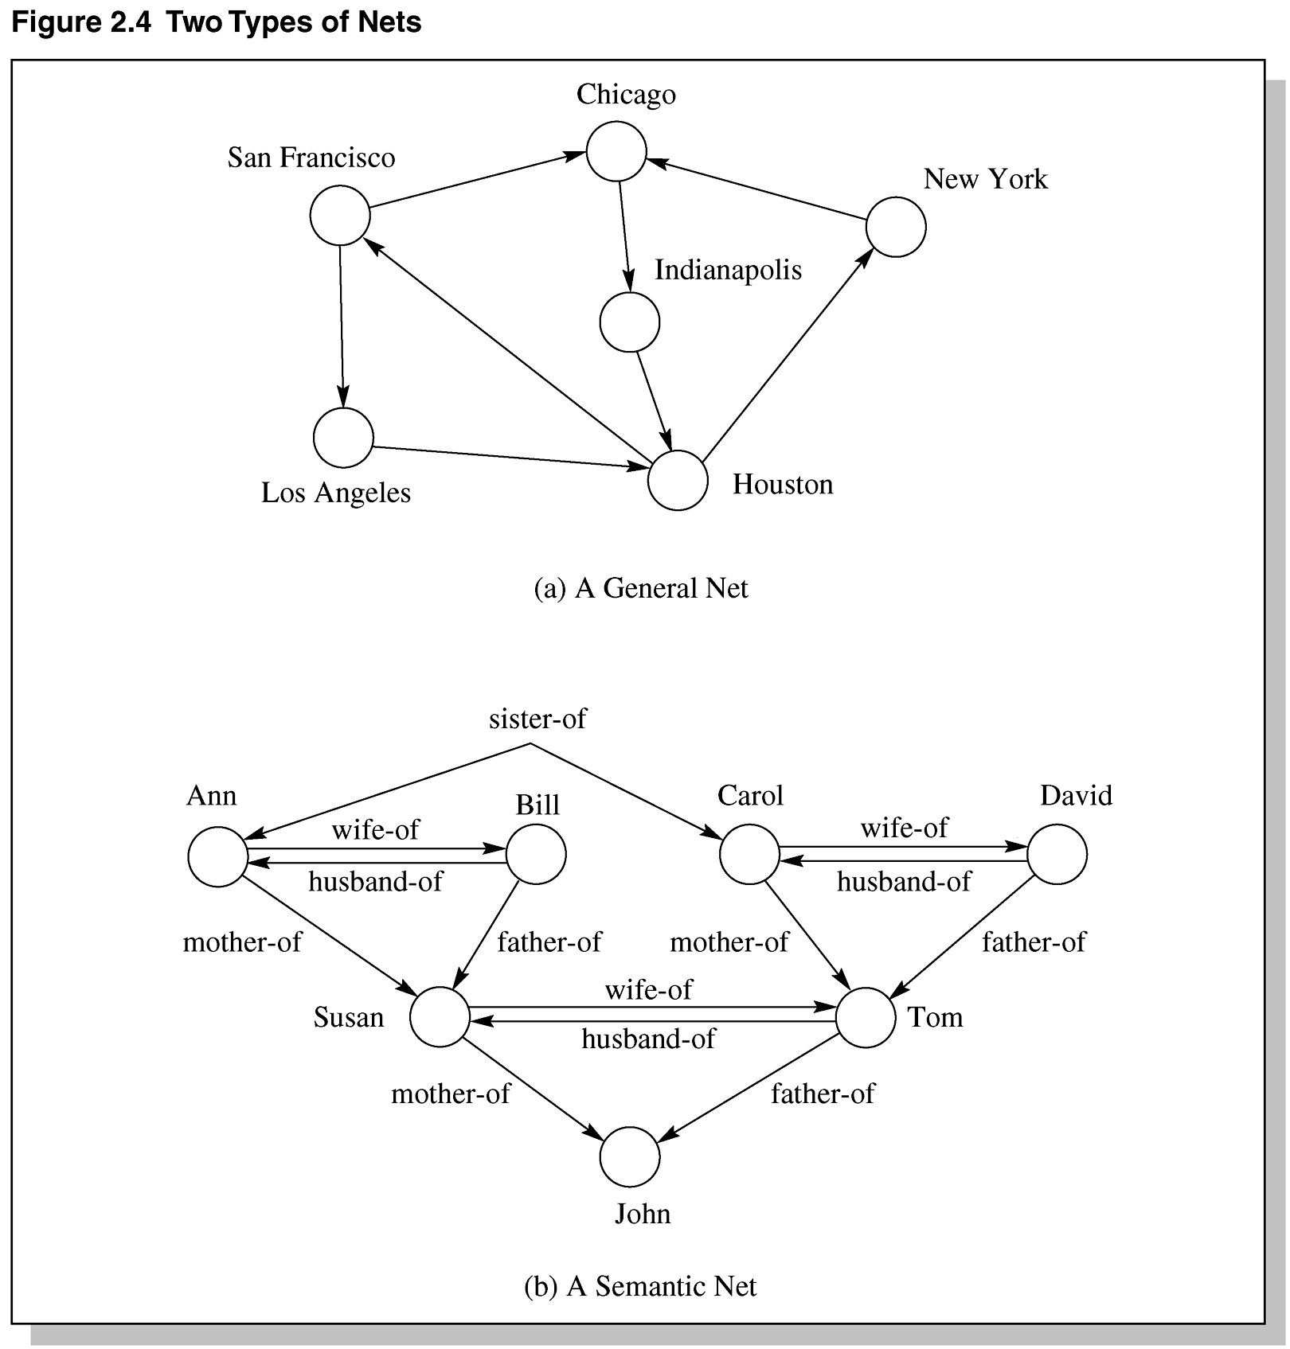
Two Types of Nets

Slide 21
Relationships
without relationships, knowledge is an unrelated collection of facts
reasoning about these facts is not very interesting
inductive reasoning is possible
relationships express structure in the collection of facts
this allows the generation of meaningful new knowledge
generation of new facts
generation of new relationships

Slide 22
Problems Semantic Nets
expressiveness
no internal structure of nodes
relationships between multiple nodes
no easy way to represent heuristic information
extensions are possible, but cumbersome
best suited for binary relationships
efficiency
may result in large sets of nodes and links
search may lead to combinatorial explosion
especially for queries with negative results
usability
lack of standards for link types
naming of nodes
classes, instances

Slide 24
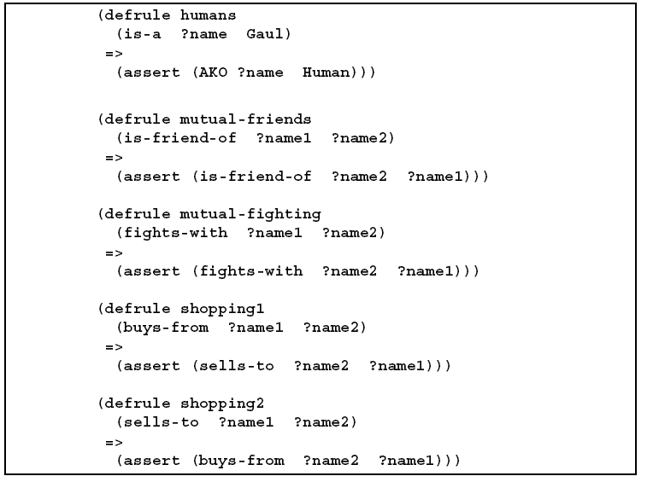

Slide 25
State and Problem Spaces
A state space can be used to define an object’s behavior.
Different states refer to characteristics that define the status of the object.
A state space shows the transitions an object can make in going from one state to another.

Slide 26
Finite State Machine
A FSM is a diagram describing the finite number of states of a machine.
At any one time, the machine is in one particular state.
The machine accepts input and progresses to the next state.
FSMs are often used in compilers and validity checking programs.

Slide 27
Using FSM to Solve Problems
Characterizing ill-structured problems – one having uncertainties.
Well-formed problems:
Explicit problem, goal, and operations are known
Deterministic – we are sure of the next state when an operator is applied to a state.
The states are discrete.
(unclear)

Slide 28
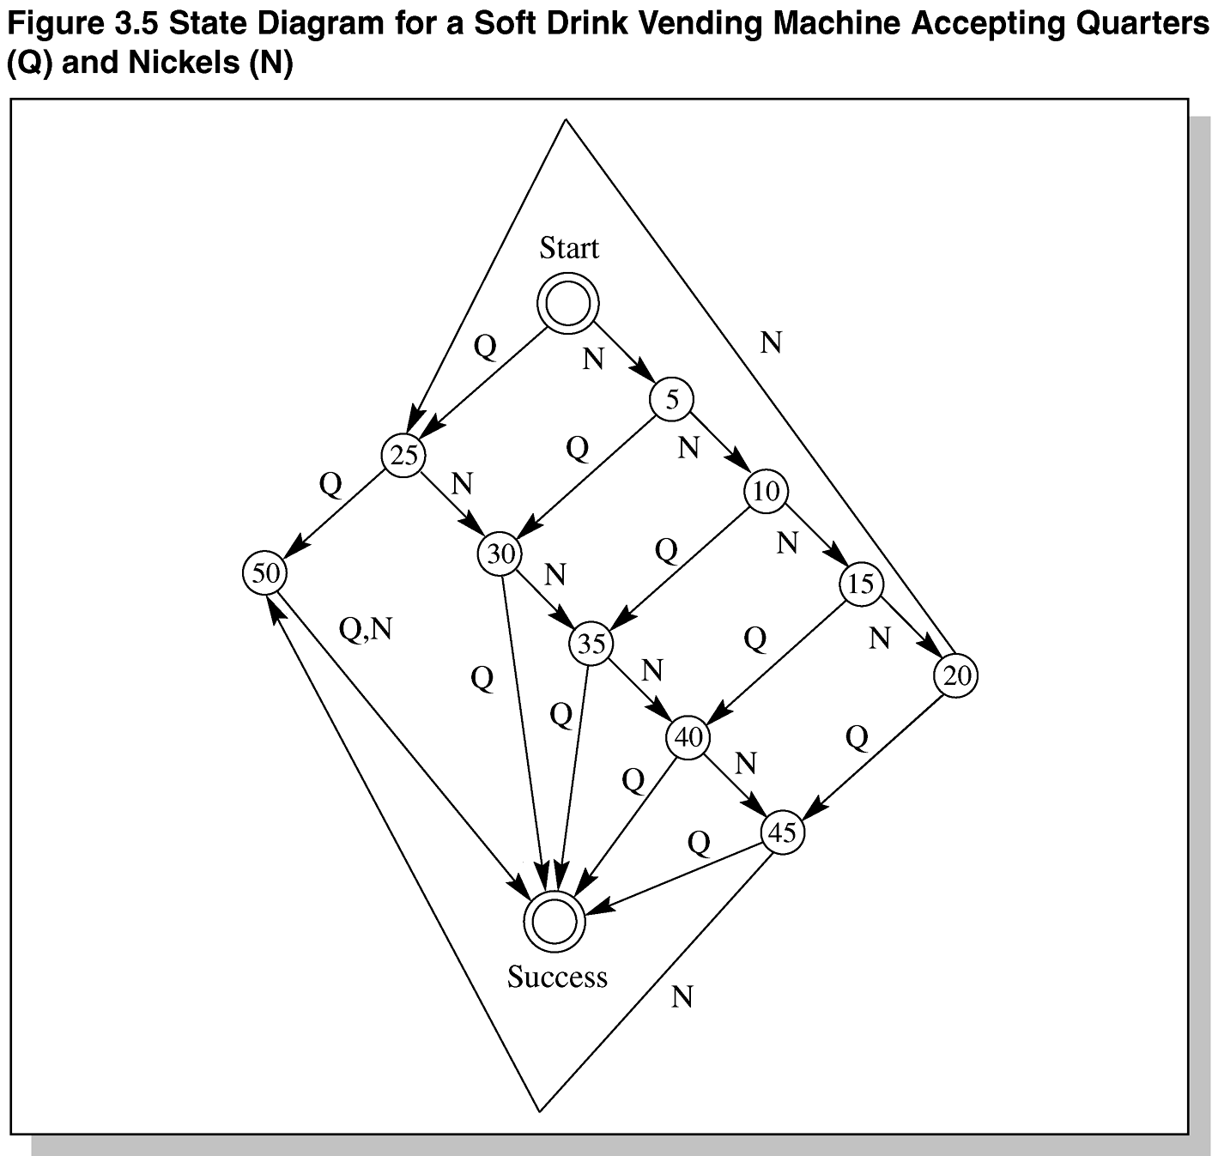
State Diagram for a Soft Drink Vending Machine Accepting Quarters (Q) and Nickels (N)

Slide 29
Frame
represents related knowledge about a subject
provides default values for most slots
frames are organized hierarchically
allows the use of inheritance
knowledge is usually organized according to cause and effect relationships
slots can contain all kinds of items
rules, facts, images, video, comments, debugging info, questions, hypotheses, other frames
slots can also have procedural attachments
procedures that are invoked in specific situations involving a particular slot
on creation, modification, removal of the slot value

Slide 30
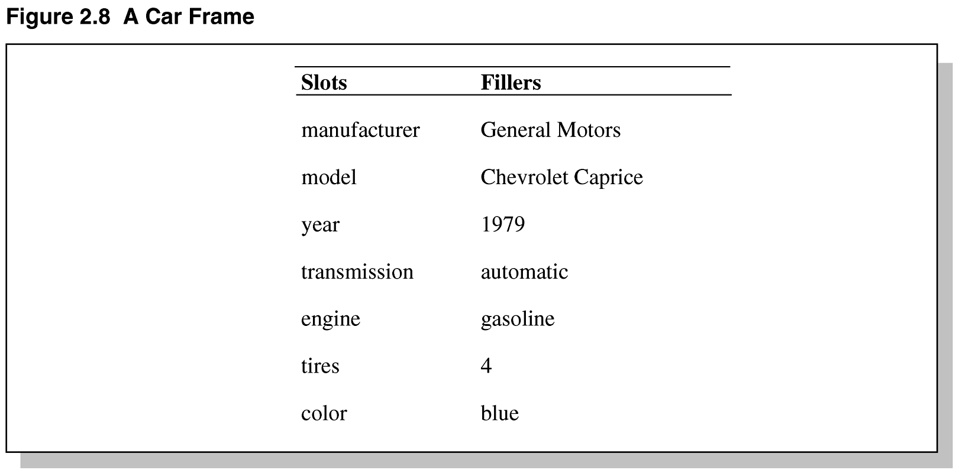
A Car Frame

Slide 31
Overview of Frame Structure
Two basic elements: slots and facets (fillers, values, etc.);
typically have parent and offspring slots
used to establish a property inheritance hierarchy
descriptive slots
contain declarative information or data (static knowledge)
procedural attachments
contain functions which can direct the reasoning process (dynamic knowledge)
data-driven, event-driven ( bottom-up reasoning)
pointers to related frames/scripts - can be used to transfer control to a more appropriate frame
[Rogers 1999]

Slide 32
Slots
may take the following forms:
values
default
used if there is not other value present
range
what kind of information can appear in the slot
if-added
procedural attachment which specifies an action to be taken when a value in the slot is added or modified (data-driven, event-driven or bottom-up reasoning)
if-needed
procedural attachment which triggers a procedure which goes out to get information which the slot doesn't have (expectation-driven; top-down reasoning)
other
may contain frames, rules, semantic networks, or other types of knowledge
[Rogers 1999]

Slide 33
Object-Attribute-Value Triple
One problem with semantic nets is lack of standard definitions for link names (IS-A, AKO, etc.).
The OAV triplet can be used to characterize all the knowledge in a semantic net.

Slide 35
Usage of Frames
filling slots in frames
can inherit the value directly
can get a default value
these two are relatively inexpensive
can derive information through the attached procedures (or methods) that also take advantage of current context (slot-specific heuristics)
filling in slots also confirms that frame or script is appropriate for this particular situation
[Rogers 1999]

Slide 36
Schema
suitable for the representation of more complex knowledge
causal relationships between a percept or action and its outcome
“deeper” knowledge than semantic networks
nodes can have an internal structure
for humans often tacit knowledge
related to the notion of records in computer science

Slide 37
Schema
Knowledge Structure – an ordered collection of knowledge – not just data.
Semantic Nets – are shallow knowledge structures – all knowledge is contained in nodes and links.
Schema is a more complex knowledge structure than a semantic net.
In a schema, a node is like a record which may contain data, records, and/or pointers to nodes.

Slide 38
Concept Schema
abstraction that captures general/typical properties of objects
has the most important properties that one usually associates with an object of that type
may be dependent on task, context, background and capabilities of the user, …
similar to stereotypes
makes reasoning simpler by concentrating on the essential aspects
may still require relationship-specific inference methods

Slide 39
Schema Examples
the most frequently used instances of schemata are
frames [Minsky 1975]
scripts [Schank 1977]
frames consist of a group of slots and fillers to define a stereotypical objects
scripts are time-ordered sequences of frames

Slide 40
Restaurant Frame Example
generic template for restaurants
different types
default values
script for a typical sequence of activities at a restaurant
[Rogers 1999]

Slide 41
Generic Restaurant Frame
Generic RESTAURANT Frame
Specialization-of: Business-Establishment
Types:
range: (Cafeteria, Fast-Food, Seat-Yourself, Wait-To-Be-Seated)
default: Seat-Yourself
if-needed: IF plastic-orange-counter THEN Fast-Food,
IF stack-of-trays THEN Cafeteria,
IF wait-for-waitress-sign or reservations-made THEN Wait-To-Be-Seated,
OTHERWISE Seat-Yourself.
Location:
range: an ADDRESS
if-needed: (Look at the MENU)
Name:
if-needed: (Look at the MENU)
Food-Style:
range: (Burgers, Chinese, American, Seafood, French)
default: American
if-added: (Update Alternatives of Restaurant)
Times-of-Operation:
range: a Time-of-Day
default: open evenings except Mondays
Payment-Form:
range: (Cash, CreditCard, Check, Washing-Dishes-Script)
Event-Sequence:
default: Eat-at-Restaurant Script
Alternatives:
range: all restaurants with same Foodstyle
if-needed: (Find all Restaurants with the same Foodstyle)
[Rogers 1999]

Slide 42
Restaurant Script
EAT-AT-RESTAURANT Script
Props: (Restaurant, Money, Food, Menu, Tables, Chairs)
Roles: (Hungry-Persons, Wait-Persons, Chef-Persons)
Point-of-View: Hungry-Persons
Time-of-Occurrence: (Times-of-Operation of Restaurant)
Place-of-Occurrence: (Location of Restaurant)
Event-Sequence:
first: Enter-Restaurant Script
then: if (Wait-To-Be-Seated-Sign or Reservations)
then Get-Maitre-d's-Attention Script
then: Please-Be-Seated Script
then: Order-Food-Script
then: Eat-Food-Script unless (Long-Wait) when Exit-Restaurant-Angry Script
then: if (Food-Quality was better than Palatable)
then Compliments-To-The-Chef Script
then: Pay-For-It-Script
finally: Leave-Restaurant Script
[Rogers 1999]

Slide 43
Frame Advantages
fairly intuitive for many applications
similar to human knowledge organization
suitable for causal knowledge
easier to understand than logic or rules
very flexible

Slide 44
Frame Problems
it is tempting to use frames as definitions of concepts
not appropriate because there may be valid instances of a concept that do not fit the stereotype
exceptions can be used to overcome this
can get very messy
inheritance
not all properties of a class stereotype should be propagated to subclasses
alteration of slots can have unintended consequences in subclasses

